Slide 1
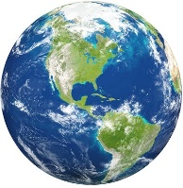
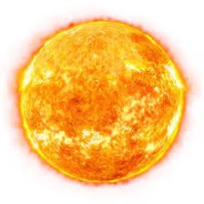
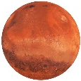
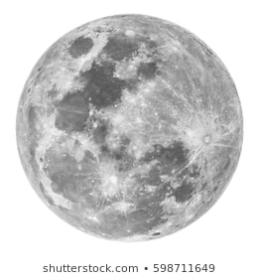
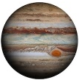
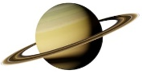
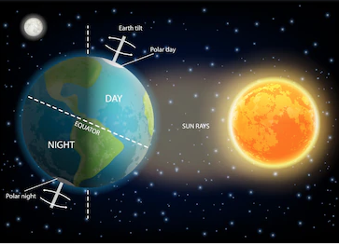
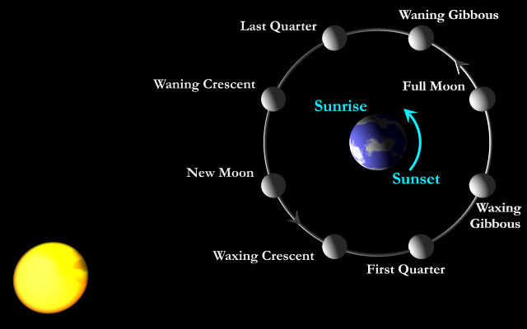
Orbit sun =
365.25 days
flat?
Mercury
My Very Educated Mother
Just Served Us Noodles
Venus
Sphere – A 3D circle, ball
Spherical – Shaped liked a sphere
Earth
Sun
Planet – A space object moving in an elliptical orbit around a star
Planetary – Linked to a planet or planets
Earth
Moon
Planets
Mars
Spherical objects
Jupiter
Is it possible to create a scaled model of our solar system?
Saturn
Lunar Eclipse
Moon Orbit
Uranus
Night and Day
Earth Spin = 24hr
27 Days
Elliptical
orbit
Neptune
Orbit – the path of a space object round a star, planet or moon
Solar system – 8 planets and their moons that orbit around the sun
Heliocentric – where the sun is the centre of the solar system
Geocentric – where the earth is the centre of the solar system

